Slide 1
SEA LEVEL PREDICTOR
SWASTIK MOHAPATRA – PES1UG23CS622
SURYA P – PES1UG23CS620

Slide 2
PROBLEM STATEMENT
To estimate sea level rise by 2025 using IBM’s Environmental Intelligence API

Slide 3
GEOSPATIAL API
This project predicts areas at risk of sea level rise using IBM Environmental Intelligence API and machine learning techniques. The model extracts elevation datasets from satellite-based SRTM Digital Elevation Models (DEM) and applies LSTM (Long Short-Term Memory) neural networks to predict future elevation risks with 95% confidence intervals.
Component | Technology
API Integration | IBM Environmental Intelligence API
Data Processing | Pandas, NumPy
Visualization | Folium, Matplotlib, Seaborn
Machine Learning | TensorFlow (LSTM Neural Network)
Statistical Analysis | Confidence Intervals (95%)

Slide 4
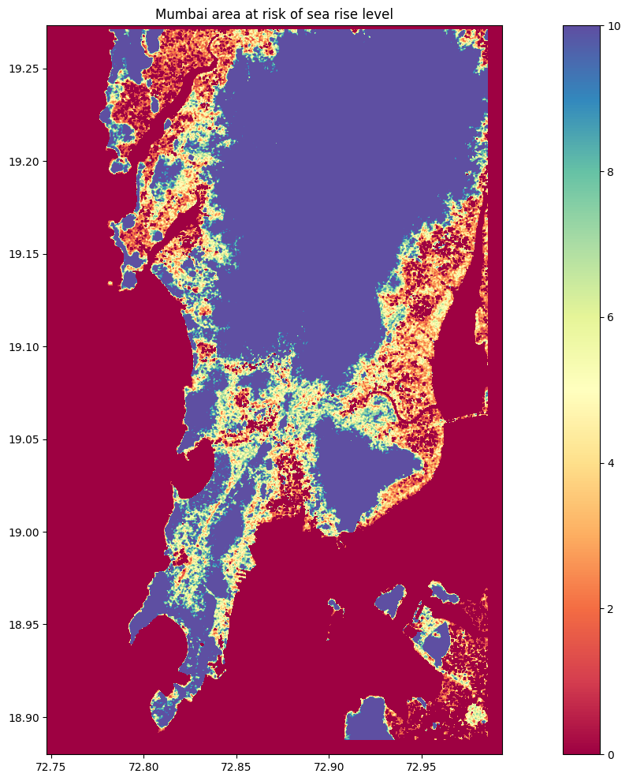
QUERY FOR DATA FETCHING & DISPLAYING
Dynamic query for preset and custom regions
Accuracy of the geospatial API: least fit square
Augmentation and prediction of data using .tiff files obtained form querying the API model and source.

Slide 5
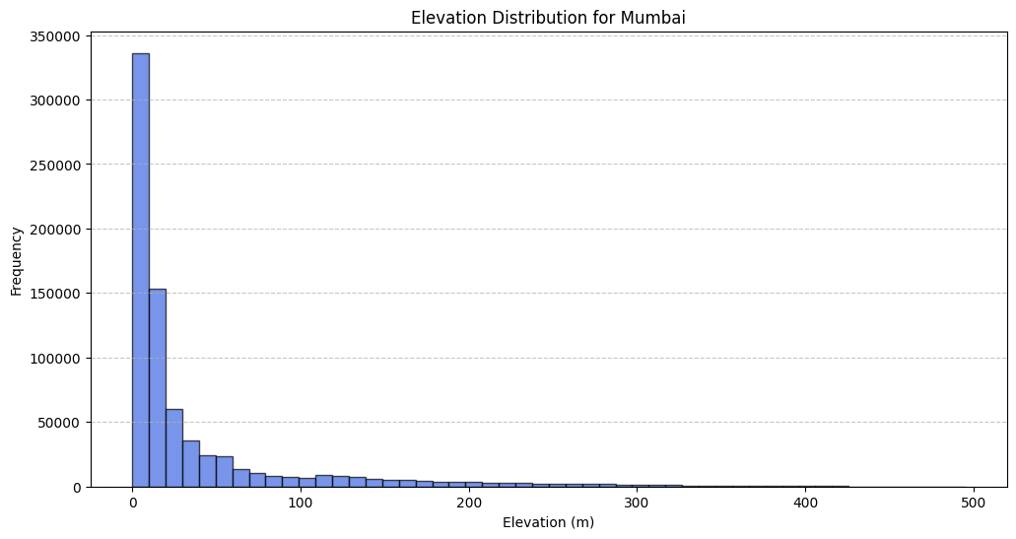
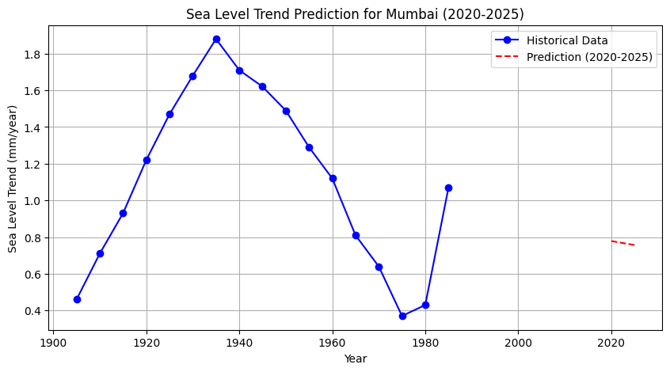
DATASET HISTOGRAM
Two stage prediction:
Prediction using dataset and plotting a histogram
Using the ML model to project optimised values – to compare and contrast values obtained from ML model and dataset
FROM DATASET

Slide 6
MACHINE LEARNING MODEL
Location Input:
Predefined cities: New York, London, Mumbai, Paris, Venice
Custom user coordinates
Data Extraction:
IBM API fetches raster elevation data (GeoTIFF) for selected coordinates.
Elevation points extracted from TIFF files.
Data Preprocessing:
Elevation data normalized between [0, 1].
Sequences prepared for time series model.
LSTM Model Training:
2 LSTM Layers with 64 hidden units.
100 Epochs with Adam Optimizer.
Mean Squared Error Loss.
Prediction with Confidence Intervals:
Predicted elevations with a 95% confidence range.

Slide 7
MACHINE LEARNING MODEL
Normalize the dataset between [0, 1] using MinMaxScaler.
Split the dataset into 80% training and 20% testing.
Prepare data in sequences of 10 elevation points.
Train the model using Adam Optimizer.
Loss Function: Mean Squared Error (MSE).
Training for 100 Epochs.

Slide 8
PREDICTING THE HISTOGRAM
How is the Histogram Prediction Done Using TensorFlow?
In this project, TensorFlow is used to create and train a Bi-Directional LSTM model that predicts future elevation risk based on the elevation dataset obtained from the IBM Environmental Intelligence API.
The histogram acts as a visual representation of the elevation dataset to show:
Distribution of elevation points in the region.
Low-lying areas at higher risk of sea level rise.
Predicted elevations for future time periods.

Slide 9
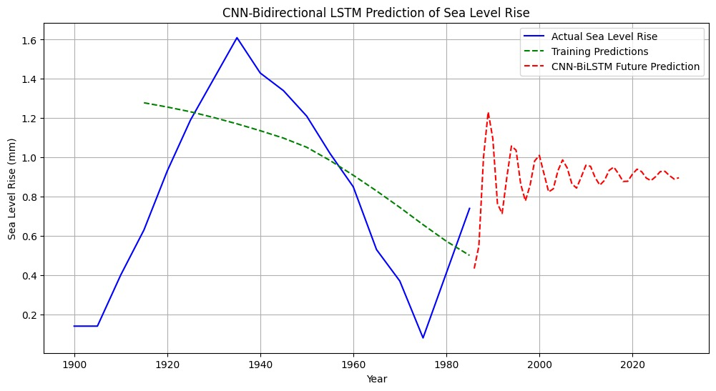
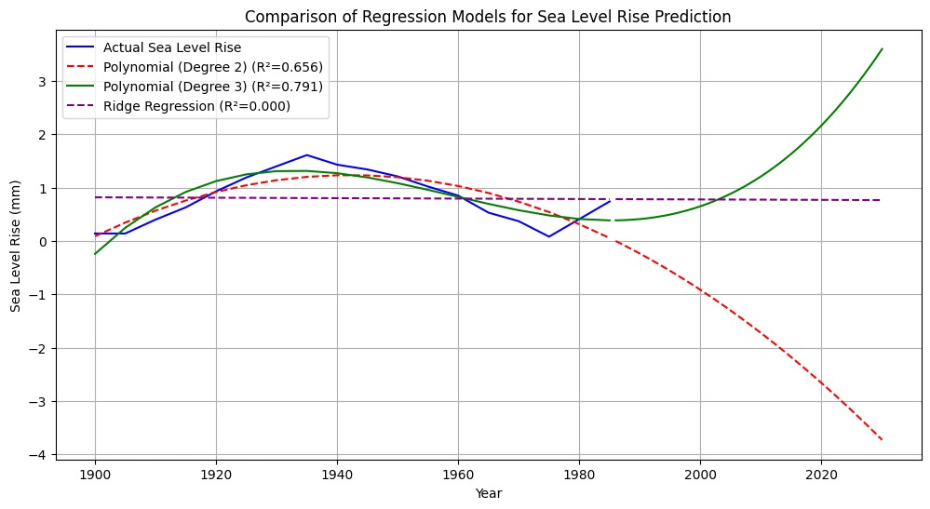
PREDICTING THE HISTOGRAM

Slide 10
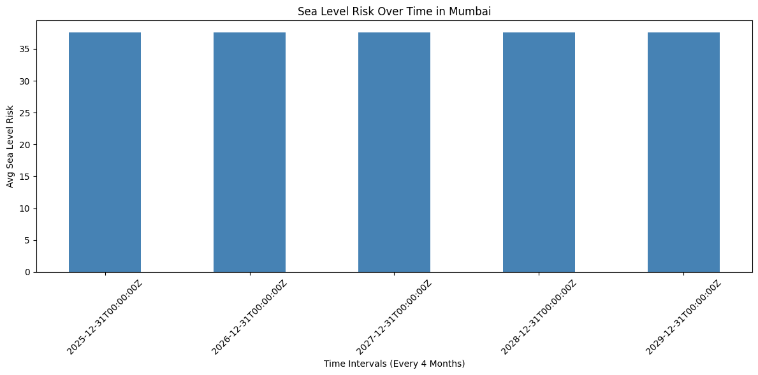
PREDICTING THE HISTOGRAM

Slide 11
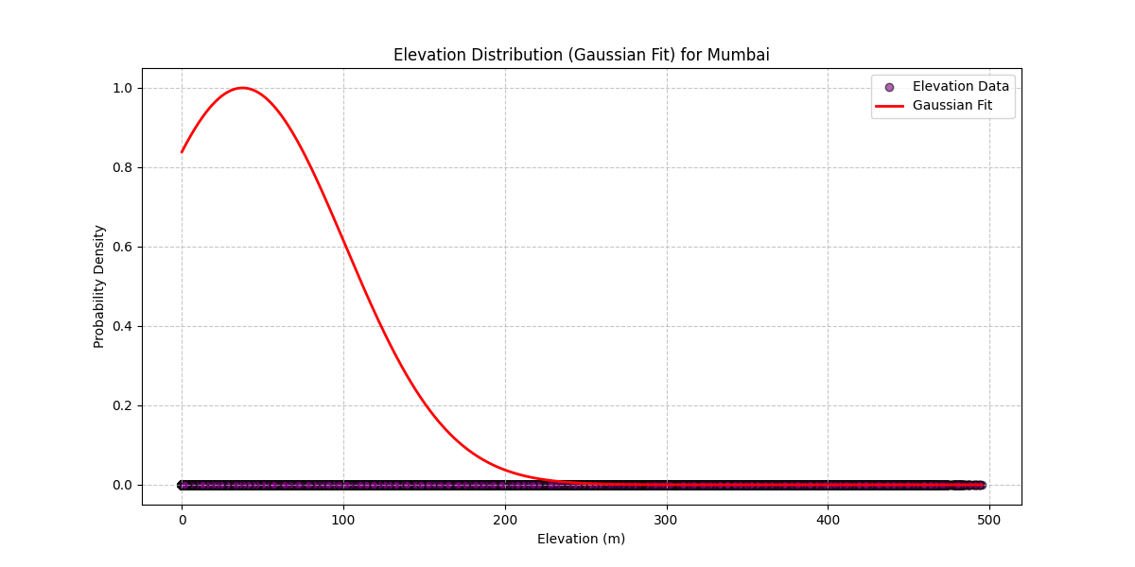
CONFIDENCE INTERVALS

Slide 12
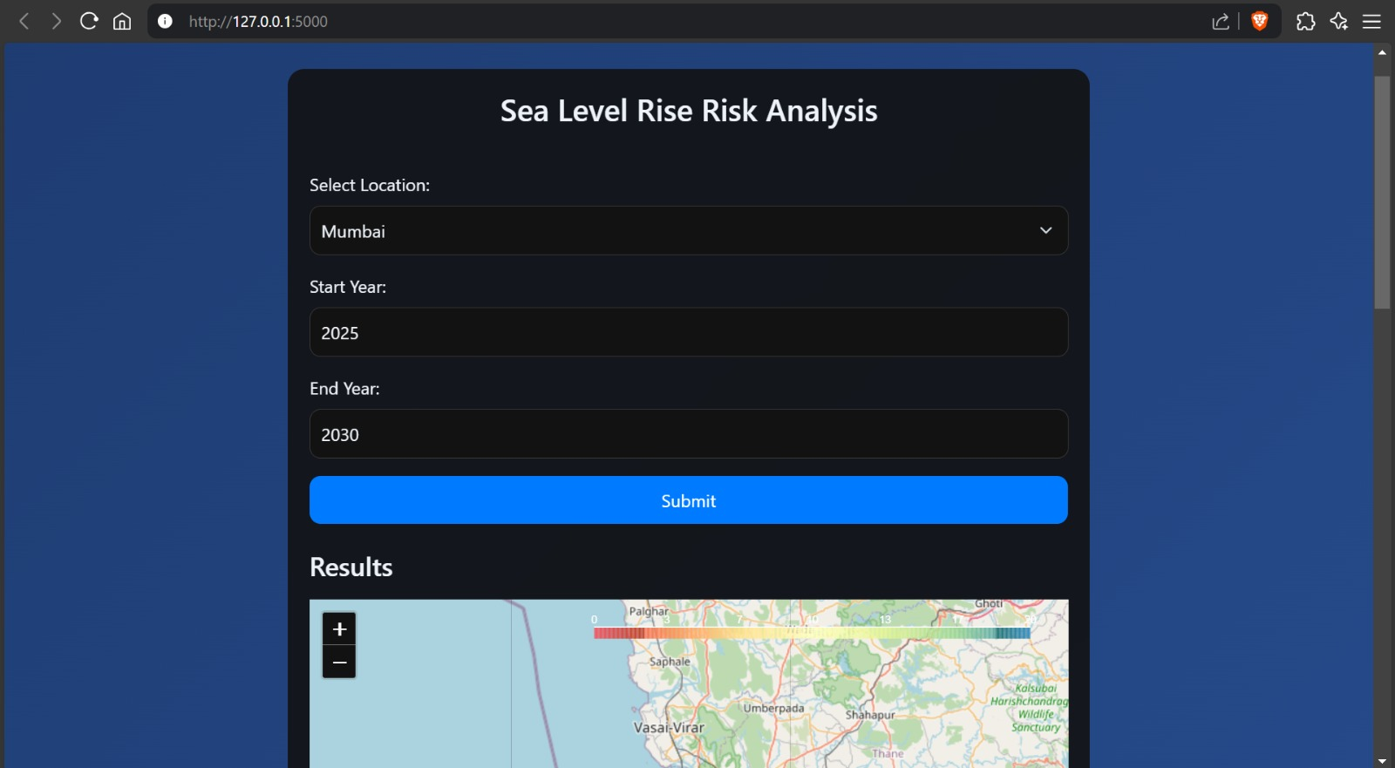
SEAFARER – THE FLASK APP

Slide 13
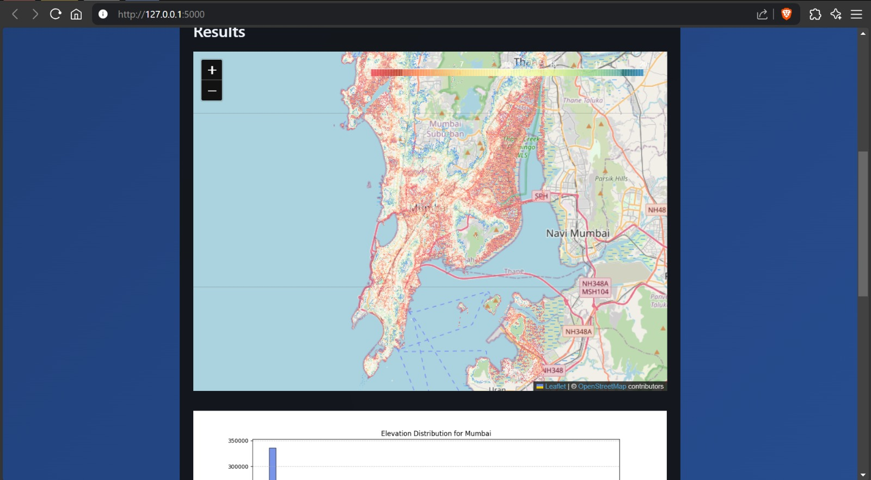
SEAFARER – THE FLASK APP

Slide 14
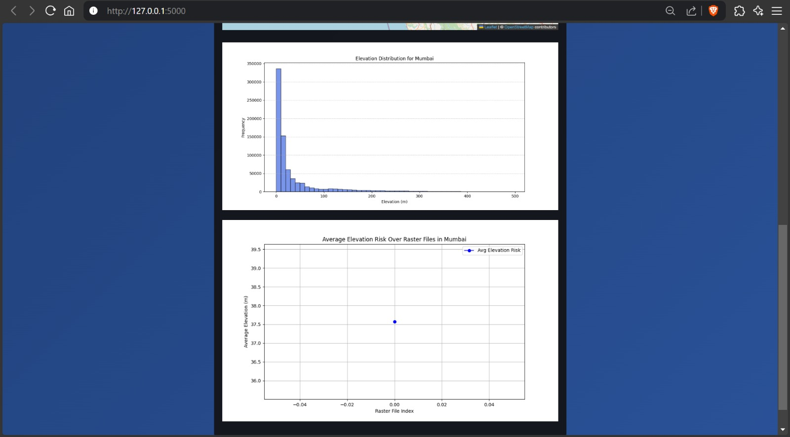
SEAFARER – THE FLASK APP

Slide 15
INSIGHTS
The recursive query call did not render multiple snapshots – one at a time.
Risk doesn’t change for different time frames – the ML model pinpointed the results for one time frame at a time.
95% confidence (upper and lower) interval.
No large dataset and outdated client input.

Slide 16
THANK YOU

